Slide 1
Image Classification using CNN
By: Ajitesh Shrivastava (N271)

Slide 2
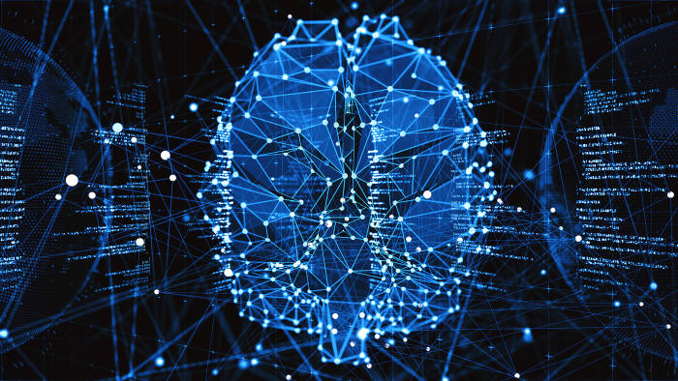
CONTENTS
ABSTRACT
INTRODUCTION
ABOUT DATASET
PREPROCESSING
MODEL EVALUATION
CONCLUSION
REFERENCE

Slide 3
ABSTRACT
Deep Learning has emerged as a new area in machine learning and is applied to a number of signal and image applications.The main purpose of the work presented in this paper, is to apply the concept of a Deep Learning algorithm namely, Convolutional neural networks (CNN) in image classification. The algorithm is tested on various standard datasets, like remote sensing data of aerial images (UC Merced Land Use Dataset) and scene images from SUN database. The performance of the algorithm is evaluated based on the quality metric known as Mean Squared Error (MSE) and classification accuracy. The graphical representation of the experimental results is given on the basis of MSE against the number of training epochs. The experimental result analysis based on the quality metrics and the graphical representation proves that the algorithm (CNN) gives fairly good classification accuracy for all the tested datasets.

Slide 4
INTRODUCTION
Convolutional neural networks (CNN) – the concept behind recent breakthroughs and developments in deep learning.
CNNs have broken the mold and ascended the throne to become the state-of-the-art computer vision technique. Among the different types of neural networks (others include recurrent neural networks (RNN), long short term memory (LSTM), artificial neural networks (ANN), etc.), CNNs are easily the most popular.
These convolutional neural network models are ubiquitous in the image data space. They work phenomenally well on computer vision tasks like image classification, object detection, image recognition, etc.
There are various datasets that you can leverage for applying convolutional neural networks. We use CIFAR-10 dataset.

Slide 5
ABOUT DATA
DATASET : CIFAR-10
The CIFAR-10 dataset is a collection of images that are commonly used to train machine learning and computer vision algorithms. It is one of the most widely used datasets for machine learning research. The CIFAR-10 dataset contains 60,000 32x32 color images in 10 different classes. The 10 different classes represent airplanes, cars, birds, cats, deer, dogs, frogs, horses, ships, and trucks. There are 6,000 images of each class.
Computer algorithms for recognizing objects in photos often learn by example. CIFAR-10 is a set of images that can be used to teach a computer how to recognize objects. Since the images in CIFAR-10 are low-resolution (32x32), this dataset can allow researchers to quickly try different algorithms to see what works. Various kinds of convolutional neural networks tend to be the best at recognizing the images in CIFAR-10.

Slide 6
PREPROCESSING
We will be defining the names of the classes, over which the dataset is distributed. There are 10 different classes of color images of size 32x32. Once we have set the class name. We need to normalize the image so that our model can train faster. The pixel range of a color image is 0–255. We will be dividing each pixel of the image by 255 so the pixel range will be between 0–1. Actually, we will be dividing it by 255.0 as it is a float operation. For the model, we will be using Convolutional Neural Networks (CNN).
In the output of shape we see 4 values e.g. (50000,32,32,3). These 4 values are as follows: the first value, i.e.(50,000/10,000) shows the number of images. The second and third value shows the image size, i.e. image height and width. Here the image size is 32x32. The fourth value shows ‘3’, which shows RGB format, since the images we are using are color images.

Slide 7
OVERVIEW OF PROJECT
Step 1 LOADING
CIFAR-10 dataset was loaded
Step 2 PREPROCESSING
Information regarding the dataset was visualized and reshaped
Step 3 EVALUATION
Different algorithms were applied to achieve maximum accuracy for the model.

Slide 8
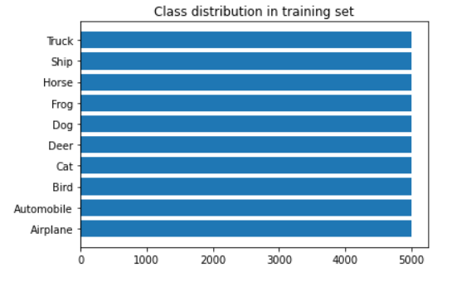
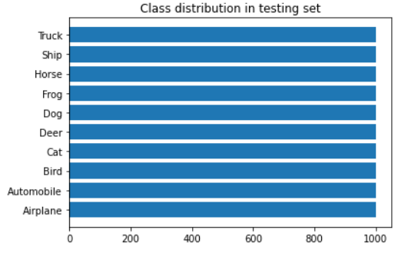
CLASS DISTRIBUTION
On Training Set
On Testing Set

Slide 9
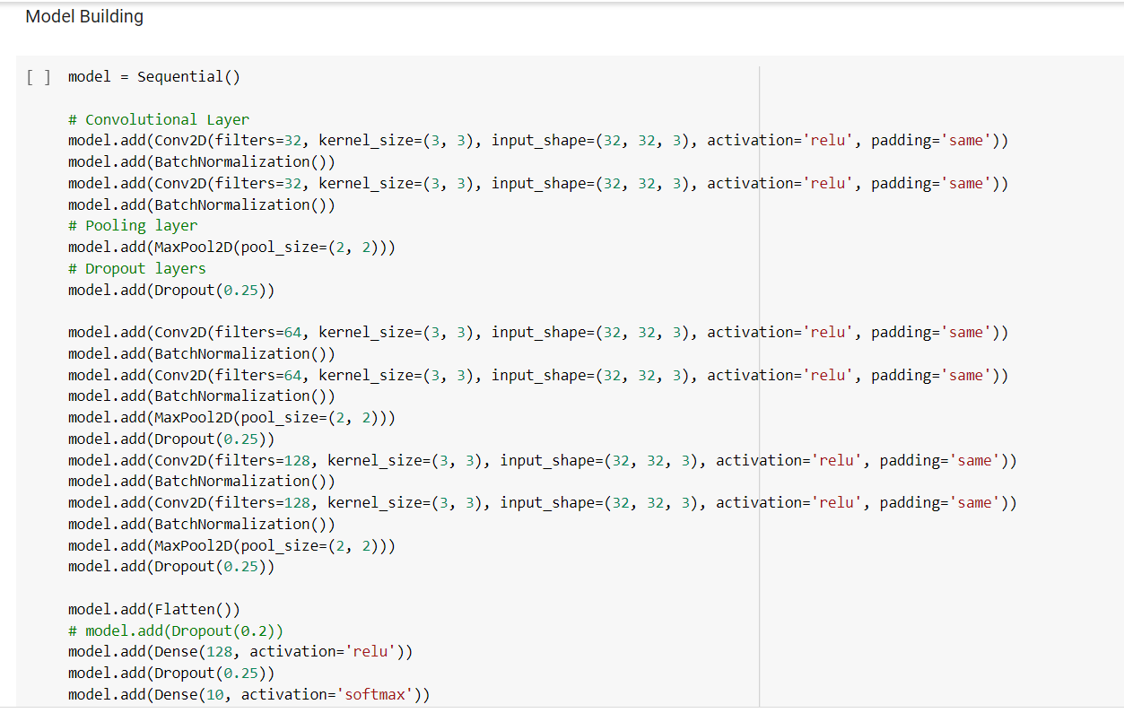
MODEL EVALUATION

Slide 10
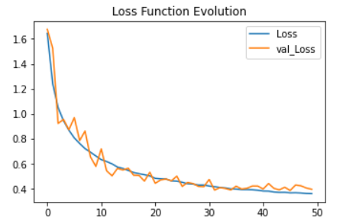
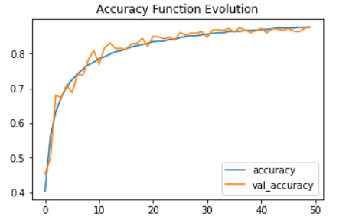
MODEL EVALUATION

Slide 11
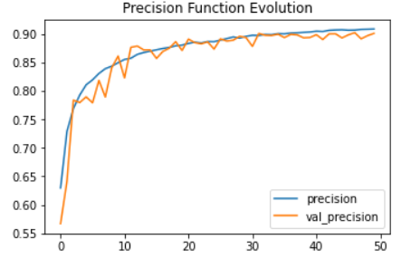
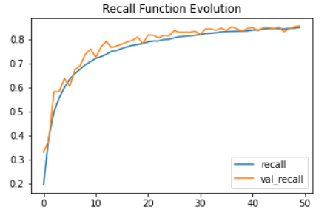
MODEL EVALUATION

Slide 12
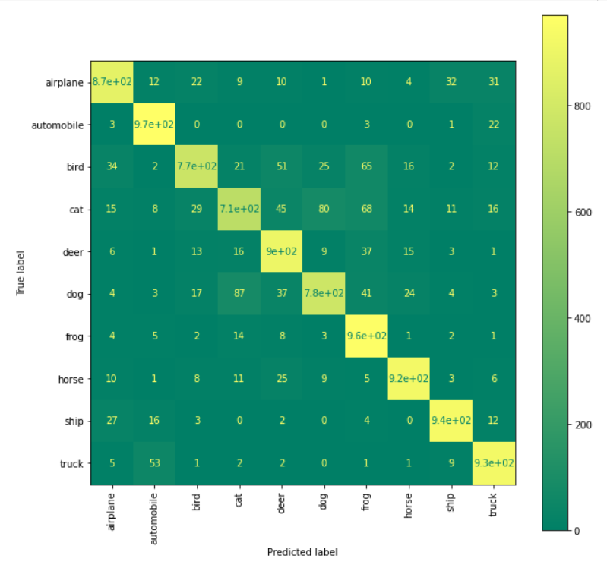
MODEL EVALUATION
Here is how the confusion matrix generated towards test data looks like.
We can see here that even though our overall model accuracy score is not very high but it seems like most of our test samples are predicted correctly.
Here’s how to read the numbers below in case you still got no idea: 51 bird image samples are predicted as deer, 32 airplane images are predicted as ship, and so on.

Slide 13
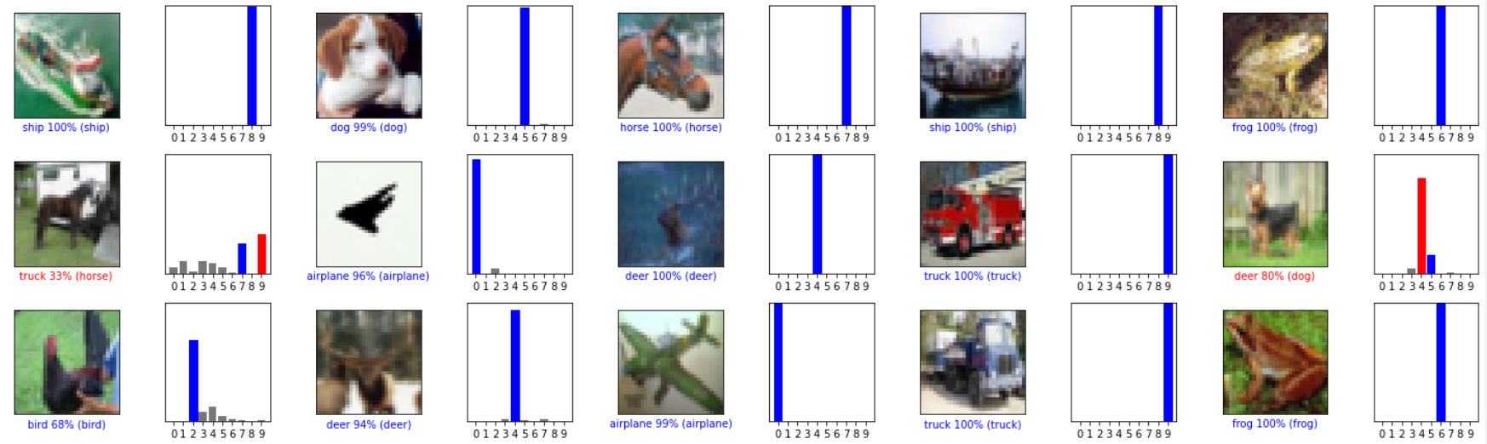
MODEL EVALUATION
Color correct predictions in blue and incorrect predictions in red.

Slide 14
MODEL EVALUATION

Slide 15
CONCLUSION
Throughout our experiments, we expect that models trained using fewer amounts of labelled data and a lot of unlabelled data should significantly outperform the models trained on fewer amount of labelled data. Similarly, we expect that models trained on large amount of labelled data should significantly outperform the models trained on fewer amount of labelled data and large amount of unlabelled data.
However, we noticed an interesting observation that a model trained using semi-supervised learning were close in terms of accuracy to the models trained on large amount of labelled data. This demonstrates that deep CNNs are capable of learning on their own, given sufficient data.

Slide 16
REFERENCE
https://medium.com/s-a-a-s/dl-basic-concept-of-cnn-2ef4fc9b039b
https://www.analyticsvidhya.com/blog/2020/02/learn-image-classification-cnn-convolutional-neural-networks-3-datasets/
https://www.geeksforgeeks.org/image-classifier-using-cnn/
https://www.upgrad.com/blog/using-convolutional-neural-network-for-image-classification/

Slide 17
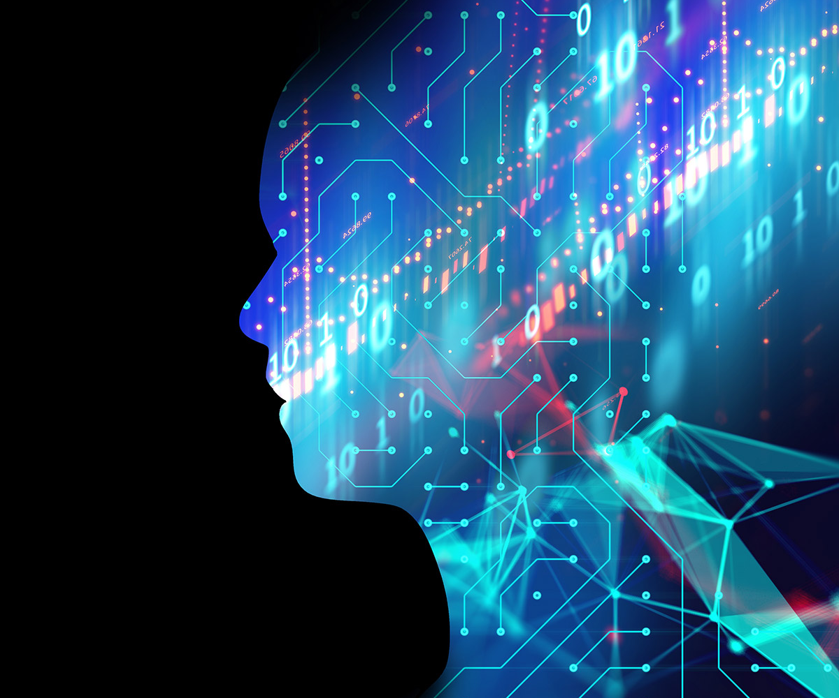
THANK YOU

